Slide 1
UNIT 7 TASK 2 Mohammed Mahin Ibnay Mamun (346584)
It System Security

Slide 2

IT Threats for organisations
How businesses are affected by threats: (page 3)
What threats currently exist for organisations? (page 4)
Deliberate Threats (page 5)
Accidental Threats/Internal Threats (page 6)
External Threats (page 7)

Slide 3
How businesses are affected by threats
The economic impact of breaches is huge because businesses can lose significant amounts of money within a short period of time, both indirectly and directly.
A business will suffer operational losses when it suffers damages to its operating capability, such as a loss of production, a loss of service, or loss of data.
In the case of a company, financial losses include losses that the company suffers economically, as well as compensation and legal fees.
As a result of a threat, a business can lose its reputation because of the loss of trust and lowered opinion of people towards that business. This could include the lack of service or the misuse of employee or customer information.
There are many other ways in how businesses affected by threats.

Slide 4
What threats currently exist for organisations?
Material shortage - Prices increase when tensions arise in an oil-producing country, driving up the cost of production for plastics companies, trucking companies, and others.
Weather - A seasonal business that is dependent on good weather is affected by these conditions.
Your computer system is hacked. During a crucial sales period, this may cause your website to go down for days.
The economy - Whatever economy you are in; you will do well if you sell something consumers need.

Slide 5
Deliberate Threats
An insider who makes malicious attempts to access data, within an organization is said to be committing deliberate threats.
Employee Actions:
A disgruntled employee might end up damaging or deleting documents maliciously as a form of revenge. In addition to destroying files and software, these threats can also compromise customer data. There are also instances where some employees who have access to important data threaten to post information about the company on the Internet.
Data Theft:
If an employee has access to data or is fired, or if an employee was dismissed from the organization, they can steal from the organization. The reason behind this attack is that most employees have direct access to this data with permission from the organization to edit, view, add data to it or remove it.
Users overriding security controls:
An employee is sometimes tempted to bypass the built-in security controls on the network, these security controls are often used to safeguard the information on the network. Those who breach these controls often do not consider the consequences of their actions, it is possible for malware to be installed on a network due to this.

Slide 6
Accidental Threats/Internal Threats
It is called accidental insider threat when an employee's actions damage a system or network, lead to the loss of sensitive data, or allow an attacker to enter a secure building by holding the door open for them.
Accidental Loss:
The most common cause of accidental data deletion and corruption is poor training and misunderstanding of procedures for employees who have access to important data. A lack of software design can also lead to data loss since some of the best ways to recover data, such as recycling bins built into operating systems, are not available on all systems.

Slide 7
External Threats
A threat from the external environment of your organization is anything that can adversely affect its performance.
There are a variety of sources of external threats to an organization. As a rule, cybercriminals aim to steal information or hold companies or individuals to ransom by encrypting data or blocking access to services. A method for protecting data is to encrypt it or block access to it. In some cases, competitors may want to target an organization to gain a competitive financial edge. Such behaviors are usually criminal in nature.

Slide 8
IT Threats for organisations
Physical Threats (page 9)
Active Threats (page 10)
Passive Threats (page 11)
Social Threats (page 12)
Social Engineering (page 13)
Unsafe Practices (page 14)

Slide 9
Physical Threats
An incident resulting in physical damage to the computer system is a physical threat.
- System failure
- physical damage
It is possible for computer equipment to be stolen or maliciously damaged, especially if it is valuable. Security is particularly at risk from theft or loss of portable equipment which may contain sensitive data since a hard disk is discarded by a computer once it is removed from the system.

Slide 10
Active Threats
A hacker who launches an active attack attempts to change data on the target or on the way to the target by exploiting a network.
Idle scanning is an example of an active threat: Spoofing packets to determine what services are available on a computer by sending spoofed ones.
Below are more examples:
Trojans
Denial of service (DoS)
Message modification
Session replay

Slide 11
Passive Threats
Usually, a passive attack involves the monitoring of a system and, when necessary, scanning for open ports and vulnerabilities. The purpose of the attack is to gain information about a target and there is no change to data on the target.
Examples
Port scanning: Port scanning can also be used to determine if a system's ports are accessible or visible over a network.
Wiretapping is also an example of a passive threat: A device that listens to telephone conversations secretly by connecting it to the line.

Slide 12
Social Threats
SNSs are used by users to exchange large amounts of personal information, which can expose them to a wide range of threats, Theft, spamming, phishing, internet fraud, and other types of cybercrime.
Modern businesses and individuals rely on social media for success. Social media is a method of communication and is susceptible to exploitation. the ease of creating legitimate and fraudulent accounts makes the medium vulnerable to fraud.
Several threats can arise from Information Security such as hacking, data theft, sabotage, and identity theft.

Slide 13
Social Engineering
A social engineer uses methods, such as hacking security or sending money, to persuade a victim to take some sort of action that may be questionable. The purpose of social engineering is to trick computer users into providing secure information to cybercriminals. The purpose of social engineering is to use software made with malicious intent.
Shoulder Surfing:
When a criminal watches over a victim's shoulder as they use electronic devices, such as ATMs, payment terminals at checkout, or even laptops or smartphones. They look over their victims' shoulders as they do this. Because it can lead to bank fraud and theft, this is extremely dangerous for the victims. If you type your pin on an ATM machine, cover it with your hand to avoid this happening.
Spear phishing
Spear phishing: These are also forms of phishing that target a specific individual to obtain sensitive information about that person. Securing the target's click is accomplished by dressing up as a trusted individual and using a spoofed email to trick them.
Dumpster Diving:
it is still possible for people to dumpster dive. Dumpster diving does not require any technical skill which is why it is so easy for one to do. It is possible to find information that one could use against a victim using this method. For example, they might find a piece of paper with a victim's bank details or passwords.

Slide 14
Unsafe practices
Risky practices could include any practices that pose a threat to an individual or worker. By performing actions that leave the company's computer system vulnerable to external hackers, employees may expose the company to security threats. There are many ways to accomplish this, below is a list of unsafe practices:
Employees using external storage devices:
Connecting personal storage devices to work on computers and laptops is very risky for employees. This is primarily because a malware or virus on the storage device can spread to the work machine. Additionally, connecting an external storage device to your work computer is a risky move because, other employees and hackers may copy or download your personal information and data, which may cause many problems.
Visiting untrusted websites:
A website that is untrusted is susceptible to cyberthreats, including malware and cyberattacks. A cyberattack can affect your site's operation, prevent your visitors from accessing it, or compromise customer information.
Downloading files from the internet from untrusted websites:
Visiting websites, we cannot trust or unknown websites where we can download any files or share our login credentials should be avoided. Untrustworthy websites can silently deliver malware through downloaded files, potentially compromising your safety.

Slide 15
Principles of information security and legality
The 3 main principles of IT Security (page 16)
Integrity (page 17)
Confidentiality (page 18)
Availability (page 19)
Legality with IT security (page 20)

Slide 16
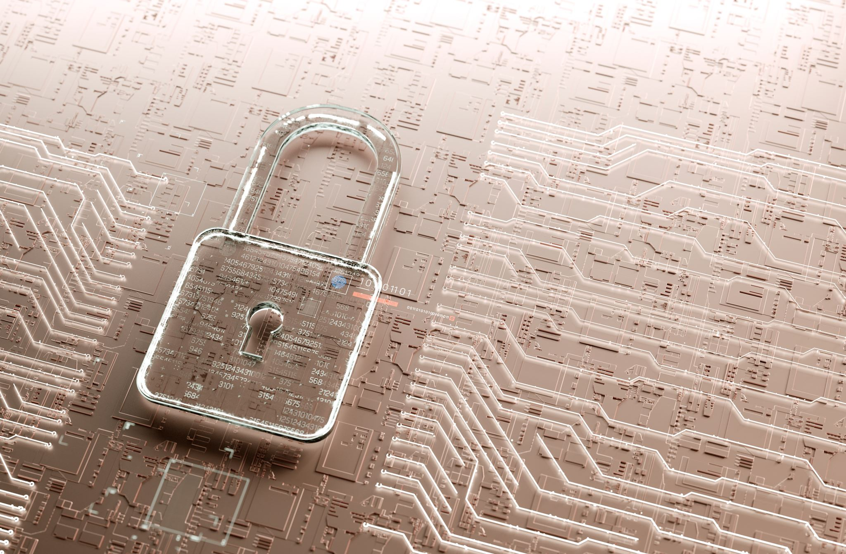
The 3 main principles of IT Security
It is important for information to be accessible to those who should be able to access it, while also being protected by the people who shouldn't have access. To ensure information security, three principles must be applied:
Availability
Confidentiality
Integrity

Slide 17
Integrity
It is crucial to maintain the integrity of data throughout its entire lifecycle and ensure that no changes are made while it is in transit; steps need to be taken to ensure that data is not manipulated by unauthorized individuals or programs.
Digital files are checked for integrity by hashing. A hash, essentially, is just a number derived from a hashing algorithm.
Integrity is also provided by digital signatures, An email's sender and recipient are verified using these methods.
Encryption is also a method of integrity. Essentially, converting information or data into code is a method of preventing unauthorized access.

Slide 18
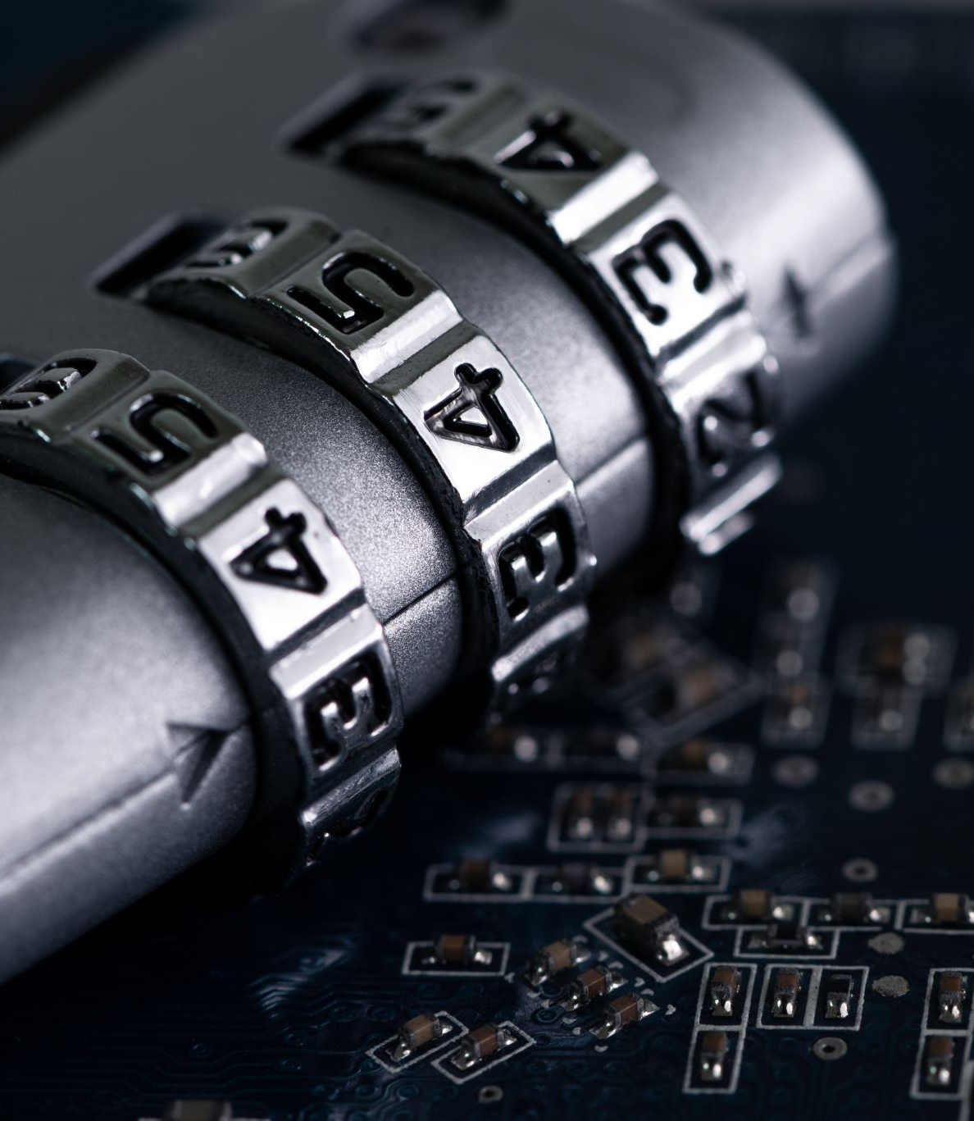
Confidentiality
Keeping secrets confidential involves protecting them from unauthorized disclosure. Every employee in an organization has a responsibility for protecting confidentiality.
It is possible to protect computer data by encrypting it, so that only those authorized to read it can see it.
The concept of confidentiality appears in a variety of methods of access control, including two-factor authentication, biometrics; touch id, face id and many others.

Slide 19
Availability
Availability means that authorized staff can access information every time they need it. Data availability is the ability to make data readily available when users need it at the point in time when they require it.
Some companies only allow data to be accessed during work times such as 9am – 5pm on Monday – Friday. Whereas other companies choose to leave their data accessible throughout the entire week for 24 hours.
In case of a disaster, an organization should ensure that they have one of the following: backup, server redundancy, disc redundancy and disaster recovery.

Slide 20
Legality with IT security
There are many ways in how organisations can use legality in order to keep their business safe and secure within it security.
In order to keep someone's data accurate, safe, secure, and lawful, organisations, governments, and businesses must comply with the Data Protection Act. This is one of numerous techniques.
Overall, the data protection act 1998 is the most used by organisations.

Slide 21
Principles of cryptography
What is cryptography? (page 22)
The 2 main principles of cryptography: (Page 23 & page 24 )
Integrity: (page 23)
Confidentiality (page 24)

Slide 22
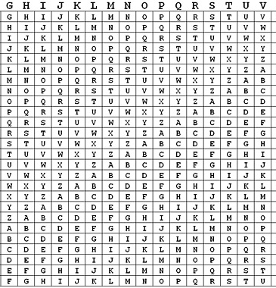
What is cryptography?
The study of cryptography is concerned with the designs of secure communications techniques that permit a message's contents to only be viewed by the sender and intended recipient.
Basic cryptography involves the use of encrypted messages in which letters are replaced with another character. To decode the message, a table or grid that defines how the letters are transposed is necessary.
For example, a table is needed which can be used to decrypt and encrypt messages. The table uses a key which is a column along the left-hand side. if you have the correct key then you can decrypt the message.

Slide 23
The 2 main principles of cryptography: Integrity
Encryption ensures messages remain confidential, but data integrity guarantees you get the actual information you're expecting, and that it hasn't been tampered with or altered in any way.
A way you can check your data hasn't been tampered with is by using cryptography and encryption to decrypt the hash. Once you has decrypted your hash, both do not match, you will know that the file has been modified.

Slide 24
The 2 main principles of cryptography:
Confidentiality
Keeping data confidential means making sure it is not shared or disclosed with anyone unauthorized.
To keep confidential information from becoming public, it can be viewed only by authorized users, Nobody is allowed to know about it except for those who are supposed to know about it. Encryption is used to encrypt data, Making it impossible to read without a key.
It is possible to achieve confidentiality through encryption. Symmetric and asymmetric encryption can both be used, and we will discuss them later.

Slide 25
Impact of IT security threats on organisations
The initial impact on organisations: ​(page 26)
Operational Impact on an organisation: (page 27)
Investigation: (page 28)

Slide 26

The initial impact on organisations:
Breach of security can have serious consequences for organisations and individuals alike. Following are possible consequences of a serious breach.
Requirements for forensic research to identify stolen or lost data.
Loss of an e-commerce website could result in financial losses.
Laws and penalties
Negative effects on reputation

Slide 27
Operational Impact on an organisation:
Several aspects of an organization's business may be dependent on computer systems which may be subject to security breaches, Their services cannot be provided as intended.
As would attacks that damage, destroy, or restrict access to information stored in an organization's computer system. An organization that suffers one of these attacks may be unable to run its business effectively.
These kinds of security breaches can have a catastrophic effect on companies whose businesses are extremely dependent on computer systems.

Slide 28
Investigation:
Investigations are usually intended to determine what caused something to happen.
Detecting that a serious IT security breach has occurred, such as a hack into its network or data theft, could take up a large amount of time, effort, Consequently, the organization's operational activities are disrupted, and an investigation will need to take place.

Slide 29

Long term impact on organisation
Long term impact on organisations:​ (page 30)
Legal Consequences (page 31)
Reputation: (page 32)

Slide 30
Long term impact on organisations:
Security breaches are frequently associated with a significant revenue loss for businesses. According to studies, 29% of businesses whose data is breached lose revenue. Almost a third experience a loss of 20% or more.
Businesses that operate in manufacturing and construction are more susceptible to attacks on designs, strategies, and blueprints. Hackers may also target revenue and reputation, as well as designs, strategies, and blueprints.
As a joke, some hackers create simple changes to your website. This may seem harmless, but subtle changes can cause a lot of damage.

Slide 31
Legal Consequences:
It is the legal obligation of most organizations to protect their users' data since many of these organizations hold very private and sensitive information that could adversely affect users if that information is revealed. The data protection act says that all data must be kept as secure as possible, so an organization experiencing a security breach may be deemed neglectful. This can be used legally.

Slide 32
Reputation:
It has been reported that security breaches cause many users to have their personal details stolen or made public after a breach has been detected, even after a security breach has been stopped. Therefore, a lot of users depend on their organization to maintain adequate security and access to their data.
An organization that has been breached can damage its reputation as being secure, causing users to stop using that service even if they were not affected, as they may no longer trust them to protect their data moving forward.

Slide 33
Case Study: Adobe
Adobe 2013 Breach:
Founded in 1982, Adobe is a California-based company. Adobe Systems, also known as Adobe, is a software company that develops multimedia and creativity software. Its most popular products are Photoshop, Acrobat Reader, and Adobe Creative Cloud.
In 2013, Adobe unfortunately was the victim of a large cyber security breach of which the passwords, usernames, and credit card details of over 30 million Adobe accounts were leaked to the public. Innocent Adobe users were fortunate that some of their credit card information was encrypted and hashed, which prevented their information from being exposed. The attackers had access to Adobe programs such as Photoshop and Acrobat.
Several sources on the internet have still written about this huge cyber-attack on Adobe. For example, I found a headline on BBC news which mentions it.

Slide 34
How can businesses protect from threat
Some examples of these techniques are:​
Limiting data access/permissions: (page 35)

Slide 35
Limiting data access/Permission
As a way of preventing threat, Some companies only allow data to be accessed during work times such as 9am – 5pm on Monday – Friday. Whereas other companies choose to leave their data accessible throughout the entire week for 24 hours.
By limiting access to their data, provides more security to their overall business as hackers and employees can’t gain access to make a threat.

Slide 36
How can businesses protect from threats
Secure communication/access to organisation network:
To protect from threats, most organisations switch of their network so trespassers and hackers can't gain access. This is a secure way to prevent anyone from making changes.
On the other hand, some organisations have to keep their network on to keep their organisation running, therfore they may restrict access at non work hours.

